Slide 1
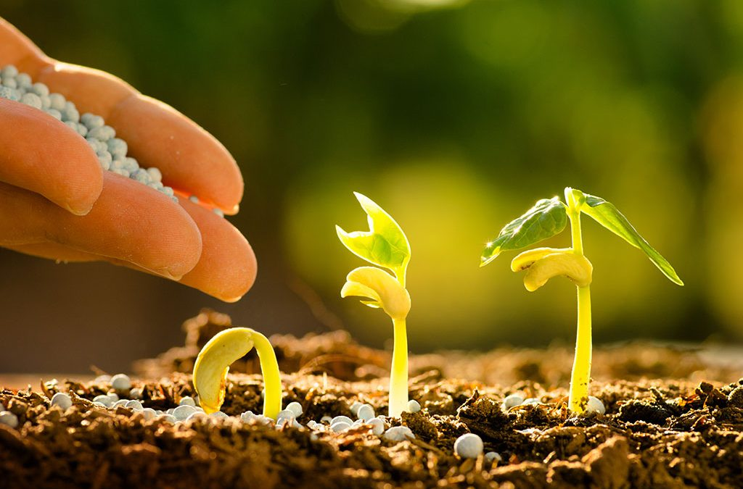
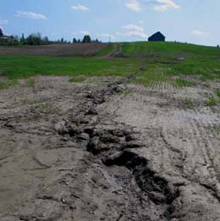
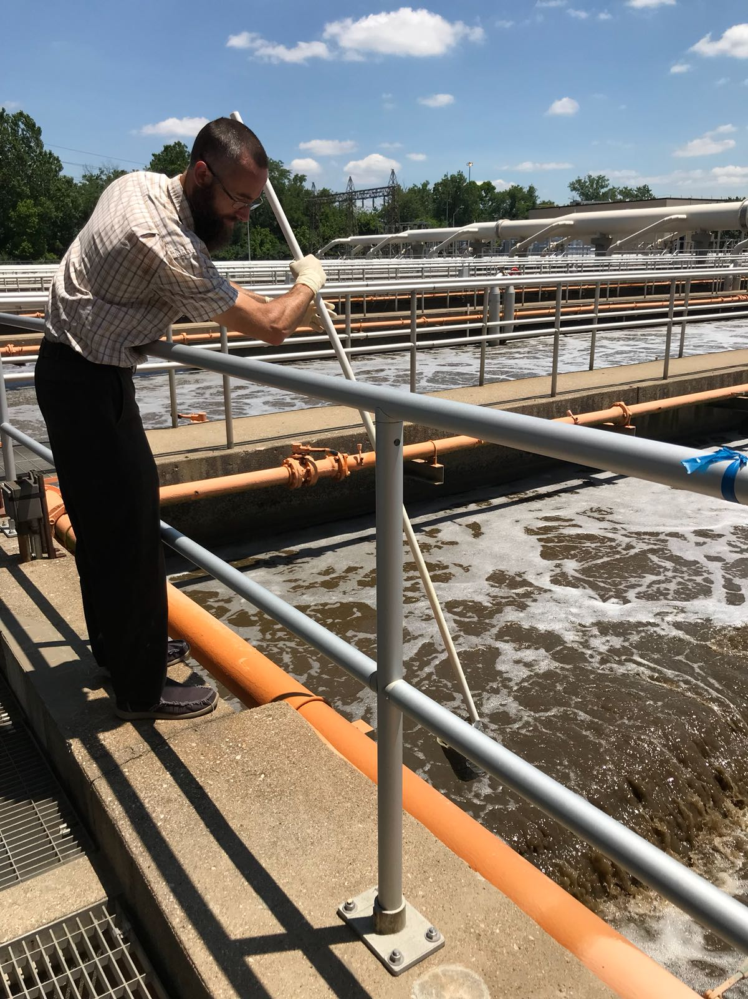
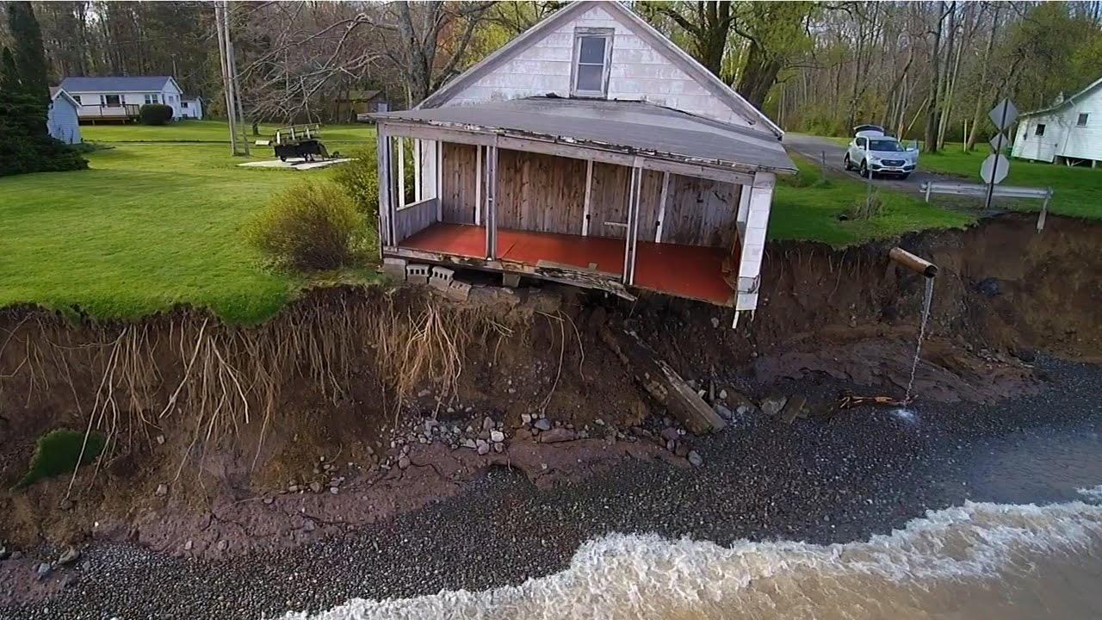
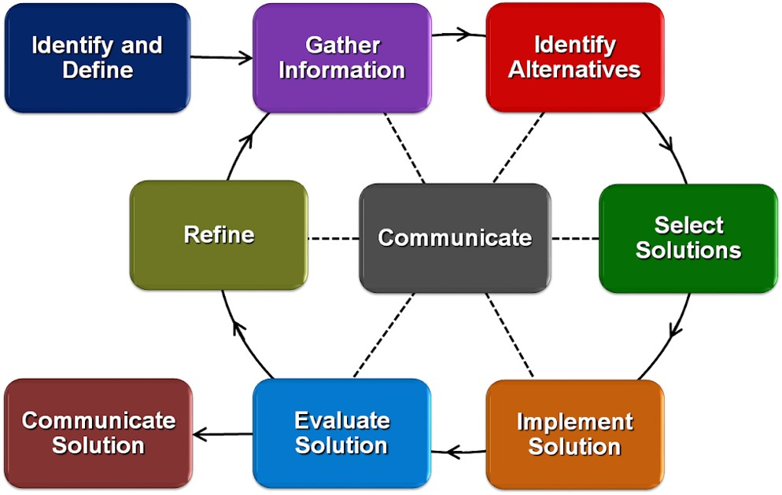
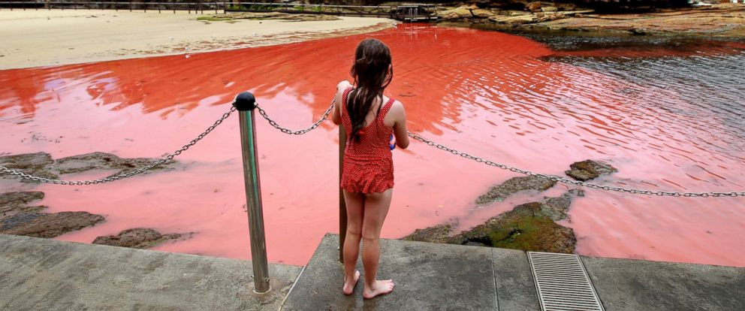
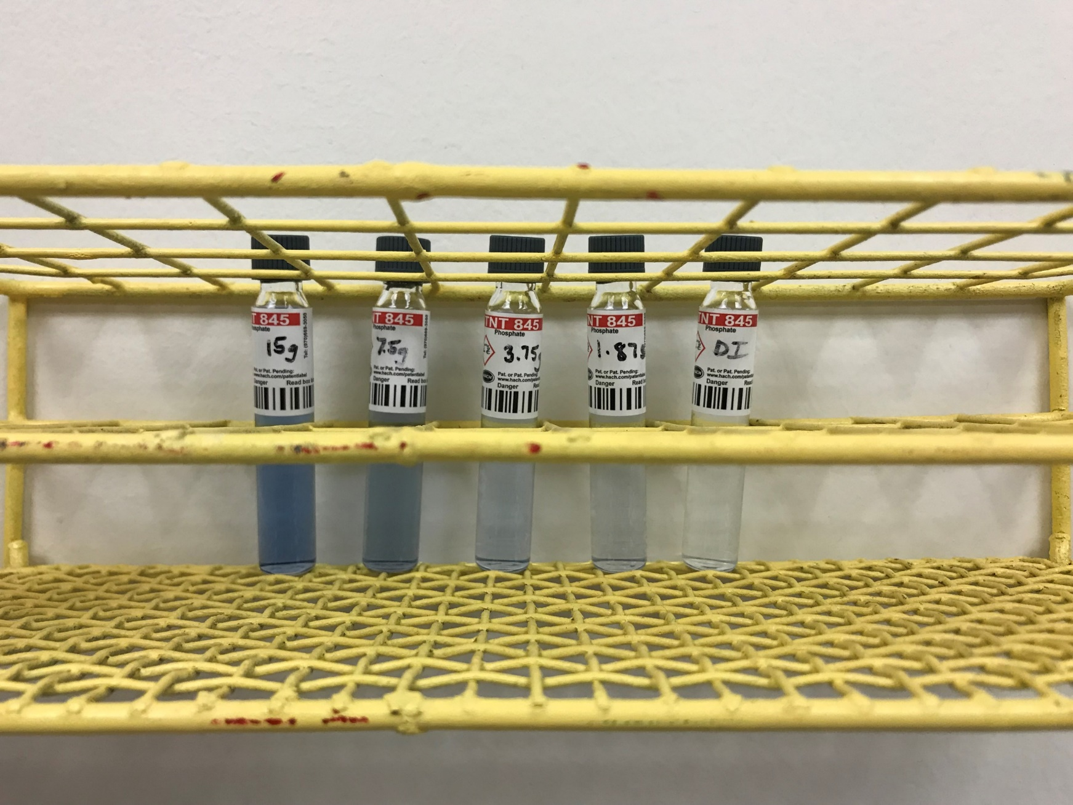
Earth’s Destructive Processes Paul Schember Norwood Middle School, 8th grade Science
Source: Mikael Guillou (MAPAQ)
Summer research:
Reclaiming phosphorus
from wastewater
Teaching strategies:
CBL and EDP
The Big Idea:
something to think about
How did THESE…
> Collected wastewater samples
> Adsorbed phosphorus with MgCO₃
pellets
> Measured & analyzed results
> Develop future uses for pellets?
Challenge Based Learning :
> Evaluate what you need to know
> Create the challenge
> Formulate a solution to the
challenge
> Share your solution
Engineering Design Process:
https://www.tfi.org/GlobalFertilizerDay
Soil being eroded
from a farm field
f
Fertilizer being applied to crops
Source: Mikael Guillou (MAPAQ)
Sewer water sample being collected from Metropolitan Sewer District in Cincinnati
YouTube
House foundation undercut by waves
…lead to THIS?
Each group of “junior engineers”
will follow the steps above as they
develop the best solution to the
challenge.
Test results from
different stages
of the process
RET is funded by the National Science Foundation, grant # EEC-1710826
https://abcnews.go.com/US/massive-red-tide-off-coast-florida/story?id=24963894
Red tide from an algae bloom at a Florida beach

